Slide 1
Voyage to A promising future
PROMIS Workshop – Sheffield
Kenwood Suite
Sheffield, England
Date: September 22, 2015
Atif Khan

Slide 2
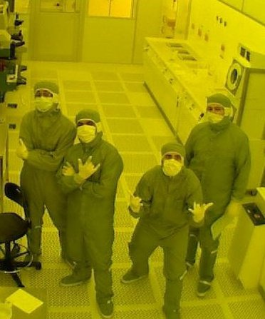
introduction
Who am I
Career Path

Slide 3
Present phase
PROMIS ESR Position
Focused Area
Postgraduate Research on Dilute Metamorphic Nanostructures and Metamaterials in Semiconductor Photonics

Slide 4
THANK YOU

